Slide 1
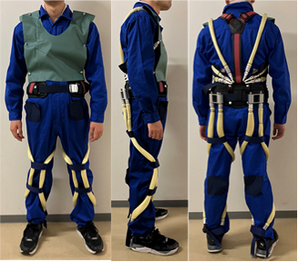
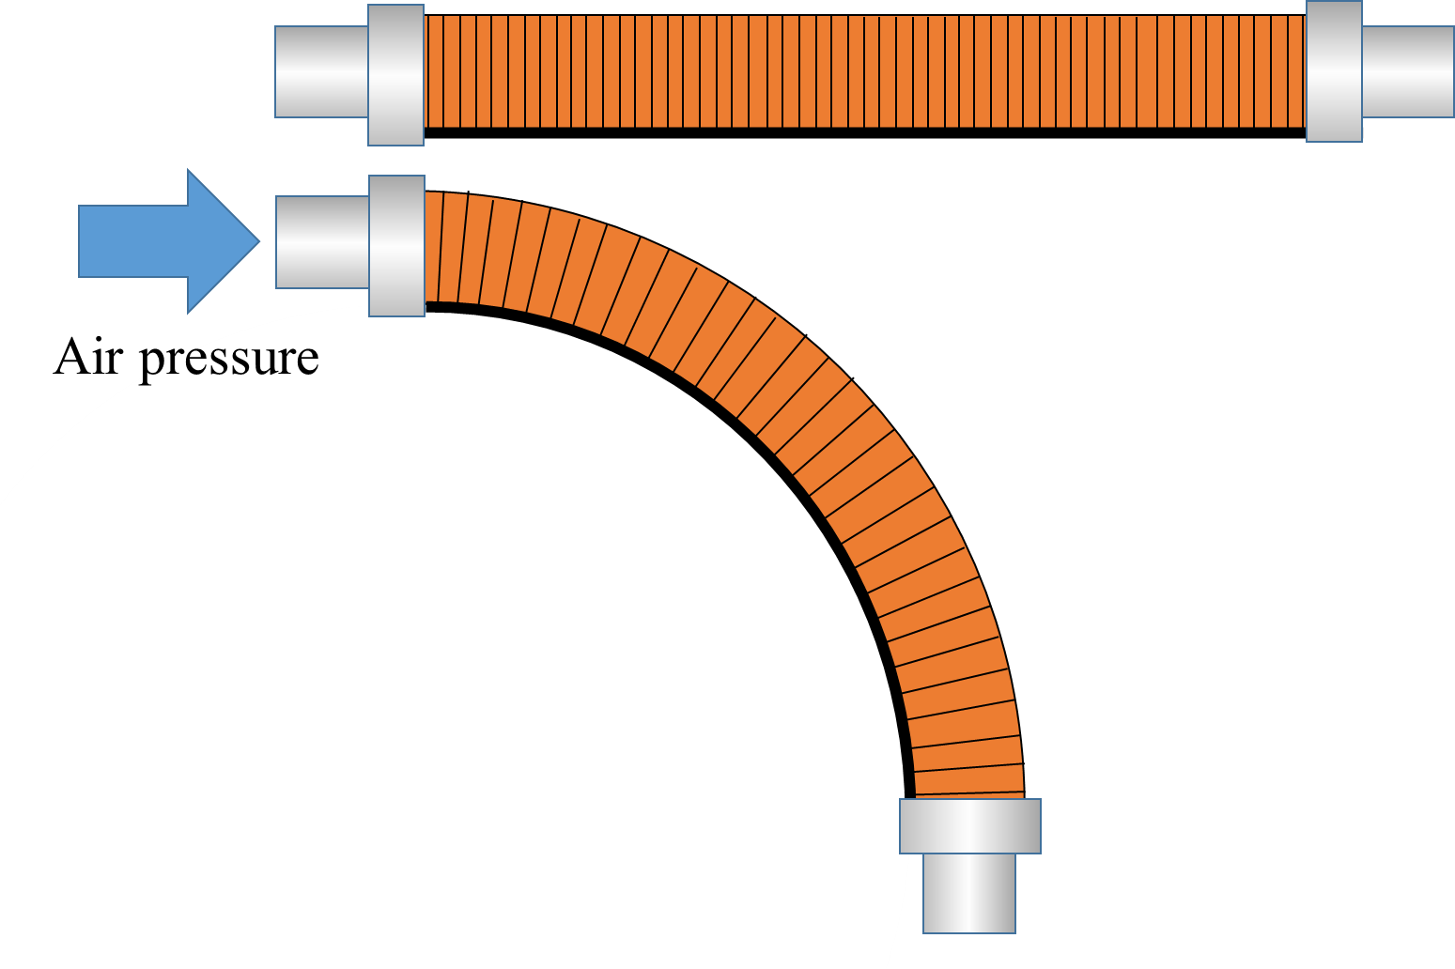
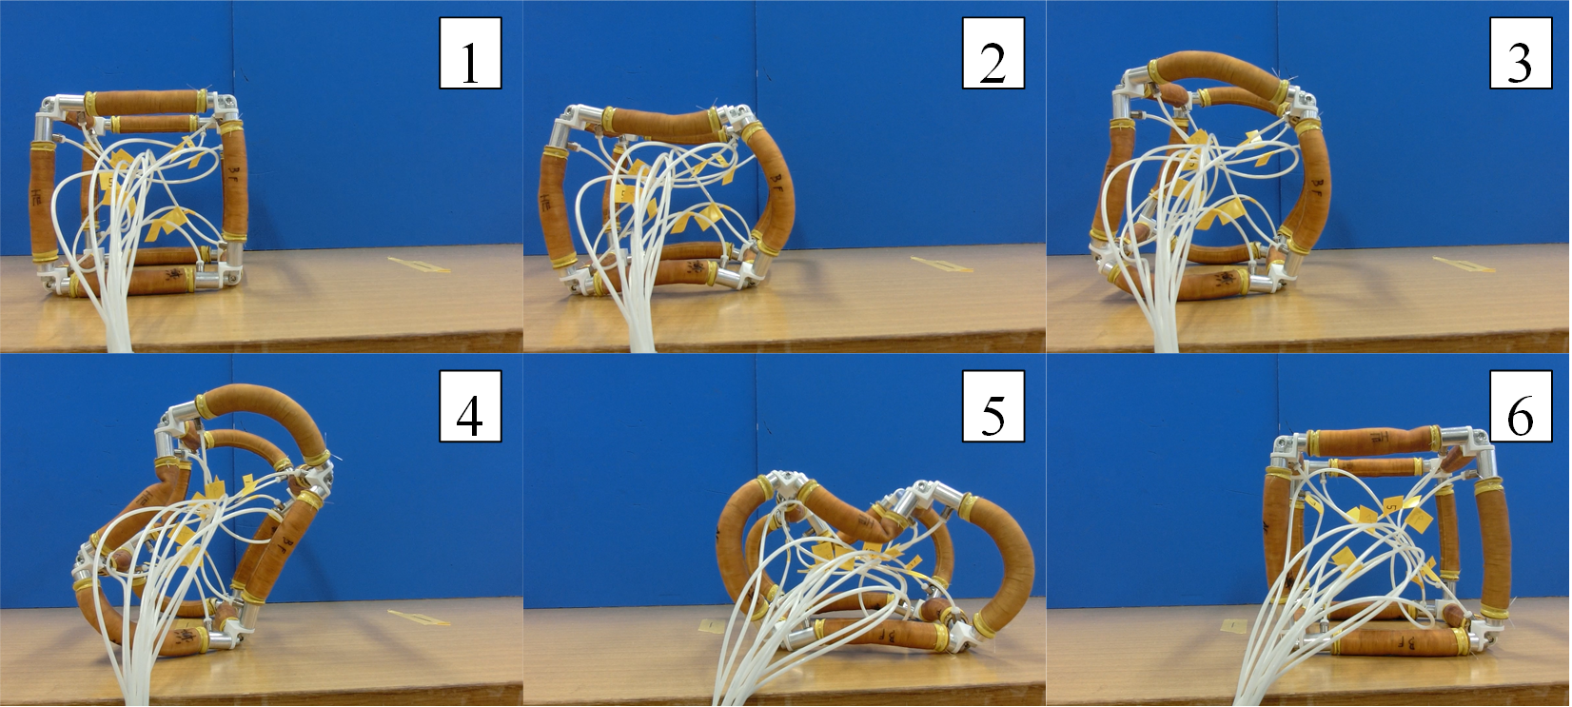

Development and control of artificial muscle and applying to soft robot
Assistant professor Hiroki Tomori
Figure 1. Smart mechanism of power assist suit.
Figure 2. Single bending unit for manipulator.
Figure 3. Rolling motion of self-deformation robot.
Content：
A pneumatic rubber artificial muscle made of rubber and fibers generates contraction and bending depending on arranged fiber by air pressure. The artificial muscle has flexibility and lightness which allow a robot to contact with human and object safely. Furthermore, its high output density can be used for practical task.
We are improving structure and material of artificial muscles for practical application, and developing soft robots. A power assist suit driven by artificial muscles have smart mechanism, high output and water and dustproof suitable for agricultural work. Furthermore, bending units consisted with lightweight actuators has advantage in developing a multi-degree of freedom flexible manipulator like an elephant nose by connecting them. A self-deformation robot with frame structure composed of artificial muscles is applicable to a probe robot which can contact with around environment safely.
Appealing point：
We pursue the research in order artificial muscles to be familiarized to the public. We are also trying to propose novel mechanisms for actuators with various functional material .
Yamagata University Graduate School of Science and Engineering
Research Interest ： Robotics
E-mail ： tomori@yz.yamagata-u.ac.jp
Tel ： +81-238-26-3217
HP ：http://tomori.yz.yamagata-u.ac.jp/

