Slide 1
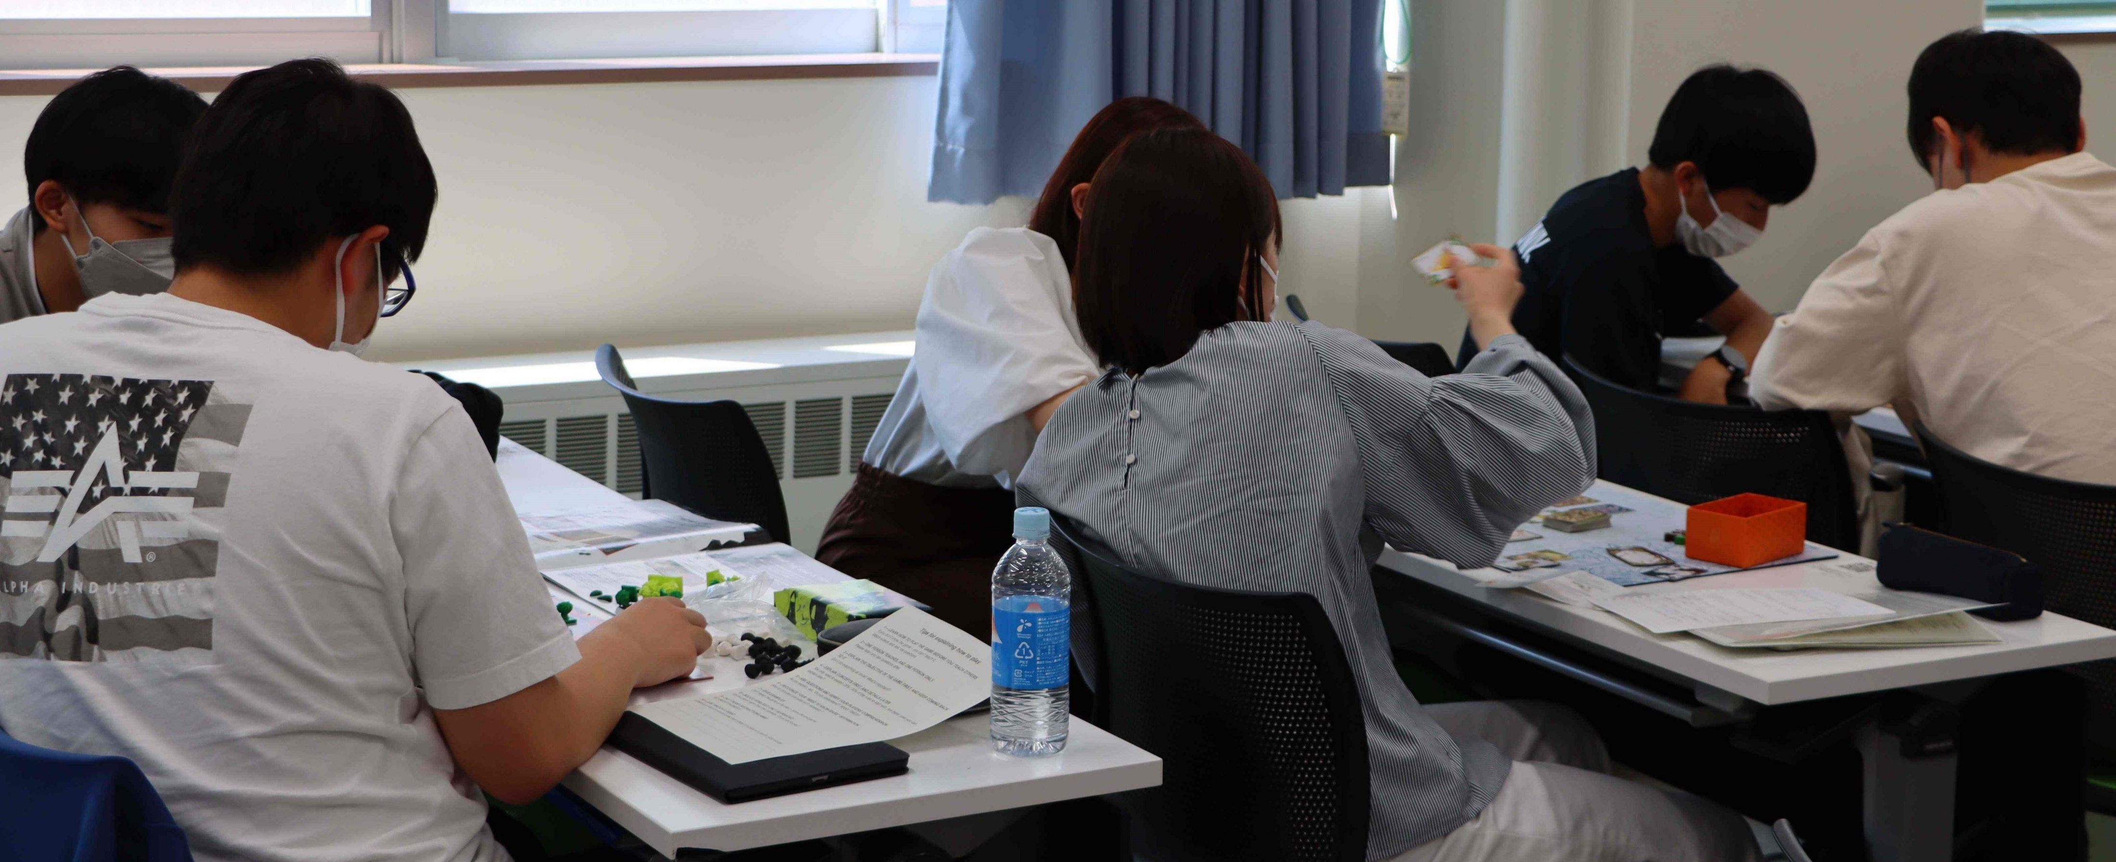
ゲームベースの学習を通じた21世紀のスキル
キーワード［21st Century Skills, Game-Based Learning］ 准教授 Gloag, Douglas
図解
Students first choose a commercially available boardgame. They have to learn how to play this game and then work out how to explain the game in easy English in a way that the game can be explained and played within 45 minutes. Students then teach their game to other students for 4 weeks while also learning their partner’s game all within 90 minutes of class. Students write a mini report on their partner’s game while improving their own game explanation for the next week. After 4 weeks, students then write a full report on their own game pointing out the good/bad aspects and how much communication took place while playing with four different partners.
内容：
Students leave high school having learnt a lot of English without the opportunity of using the English they’ve remembered. This research shows how 21st Century Skills can be taught to students alongside English instruction to give students confidence in their communication and social skills while also focusing on learning and then teaching board games to others in class. Students get to actively practice all four skills while also using critical thinking, logical thought and improving their explanation techniques. These 21st Century Skills can be used throughout the students life and after university in their future careers. This research also shows aspects of intrinsic motivation and offers students a chance to use English in a low-pressure class environment.
アピールポイント：
Students have moved on from effectively learning from textbooks or 90-minute lectures. Game-based Learning offers students a way to use English while focused on critical thinking and logical thought. Explanation skills are also focused on.
分 野： Game-Based Learning
専 門： 英語教育
E-mail ： gloagd@kdw.kj.yamagata-u.ac.jp
Tel ： 023-628-4483
Fax ： 023- no one uses Fax machines anymore!
HP ：
写真の貼り付け願います

